Slide 1
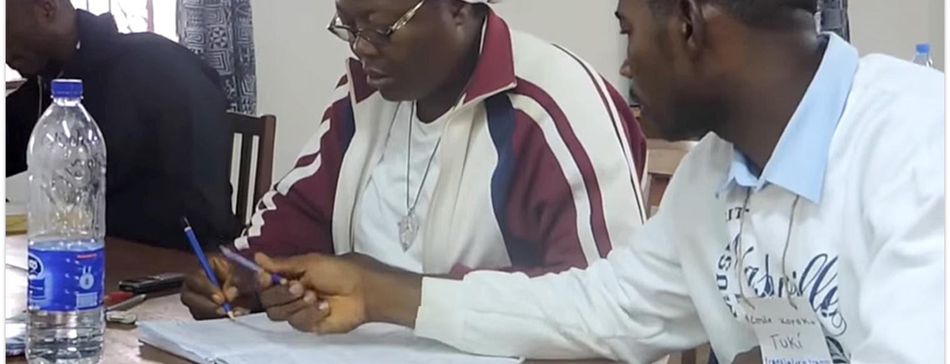
Then Jeremiah called Baruch the son of Neriah; and Baruch wrote on a scroll of a book, at the instruction of Jeremiah, all the words of the LORD which He had spoken to him (Jer. 36:4).
All Scripture is taken from the New King James Version®. © 1982 by Thomas Nelson, Inc. Used by permission. All rights reserved.
MAST Drafting Steps

Slide 2


MAST
Mobilized Assistance Supporting Translation
M
Mobilized—many people working together to advance Bible translation globally
Assistance—assisting the local church worldwide
Supporting—providing training to the local church—processes, resources, and tools
Translation—partnering to get a Bible in Every Language
A
S
T

Slide 3
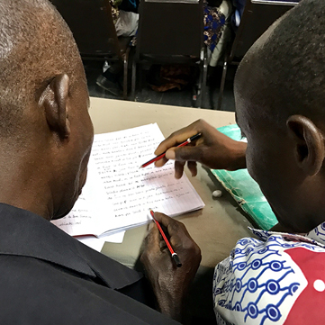

The 8 Steps of MAST
Drafting Steps
Checking Steps
Consume
Verbalize
Chunk
Blind Draft
Self-edit
Peer-edit
Key Word Check
Verse-by-Verse Check

Slide 4
Drafting Steps Defined
1
Consume
Think about what the passage means
How sweet are Your words to my taste, Sweeter than honey to my mouth!
Psalm 119:103
5–7 minutes

Slide 5
Drafting Steps Defined
2
Verbalize
Summarize the passage to someone in your language
With my lips I have declared All the judgments of Your mouth.
Psalm 119:13
2–3 minutes

Slide 6

Drafting Steps Defined
3
Chunk
Break the passage down into smaller pieces based on meaning
Open my eyes, that I may see Wondrous things from Your law.
Psalm 119:18
5-7 minutes
(Usually
1–4 verses)

Slide 7
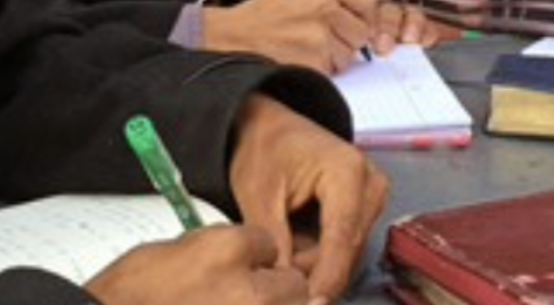
Drafting Steps Defined
4
Blind Draft
Read chunk, write what you remember
Your word I have hidden in my heart, That I might not sin against You. Blessed are You, O Lord! Teach me Your statutes. Psalm 119:11-12
Complete without looking back at source text

Slide 8
Try it
1
2
3
4
Consume
Verbalize
Chunk
Blind Draft
Think about what the passage means
Summarize the passage to someone in your language
Break the passage down into smaller pieces based on meaning
Read chunk, write what you remember
5–7 minutes
2–3 minutes
5-7 minutes
(Usually
1–4 verses)
Complete without looking back at source text

Slide 9
Try it
Are you surprised by what you can do?
What is difficult?
Are you ready for the next steps?

